Slide 1
EBUG TRACKER-BUG TRACKING SYStem
Bendi Amulya
Shubham Kapoor
Uma Shankar
Shreya Dubey
Anirudh BHaradwaj
Soumya Sathputhe

Slide 2
ABstract
Bug Tracking System is a web-based application that is designed to help quality assurance and programmers keep track of reported software bugs in their work. Bugs will be assigned to a person with a bug id, flag, description, project name.
Nowadays, when project are so extensive defects or bugs have been existed as a problem in the system and they are normally inevitable in software development. A bug could be in either a program’s source code or its design.

Slide 3
Purpose of the Project
Bug Tracking System is the application whenever the customer encounters any bugs in his software, he can raise a ticket and report it to the Administrator.
The main intention behind the Bug Tracking System is that to track bugs and report them and resolve them by the Employee.
Store the bug information with a unique id in the database and track the path and to whom it is assigned to.

Slide 4
Software requirement specification
MINIMUM HARDWARE REQUIREMENTS
Processor : An Intel Pentium 4 processor or later that's SSE3 capable
Operating System
For Mac : OS X El Capitan 10.11 or later
For Linux : 64-bit Ubuntu 14.04+, Debian 8+, openSUSE 13.3+, or Fedora Linux 24+
For Android : Android Lollipop 5.0 Storage
Hard-Disk : 256GB Recommended
RAM: 4Gb Recommended

Slide 5
Technology Stack For App Development
FrontEnd Development Stack
Angular
HTML/CSS
BOOTSTRAP
BackEnd Development Stack
Spring-Boot
Hibernate for ORM
mySql/Oracle for database
Testing using Junit Mockito
Other
IDE for Backend : Eclipse/ STS
IDE for FrontEnd : vsCode

Slide 6
Functional requirements
ADMIN
This module has the entire access to all other modules, It can login to the app and can enter the details of staff, project, view bugs send from the Customers. The admin can also assign work to staffs, view bug case flow status details, send messages to customers using this bug tracking application
EMPLOYEE
Employee can login to the site using username and password. Then he/she can view the all bugs assigned to them and able to check tickets based on critical level and status. He can directly give solution message to customers or he/she can assign the bugs to other staffs if the bug is related to them
CUSTOMER
Customer can view bugs case flow details with which he/she is involved. The customer registers in to the applications and login to the site using username and password. Whenever a bug is raised from his software, he sends the bug details to the administrator with print screen of the bug generated. He/she may see the bug case flow details and bug status along with remedy details at any time using the ticket number generated during new bug entry.

Slide 7
Functionalities of Each module
ADMIN:
Adding Employee
Adding projects
Assigning tasks to the employees
Sending messages to the customer
Able to update critical level of the bug
EMPLOYEE:
Resolve the bug and send solution to the customer
Update critical level and status of the ticket
Assign bugs to other employees if its not related to him
CUSTOMER:
Register and login into the website
Raise ticket for the bug encountered
View the ticket details using ticket id

Slide 8
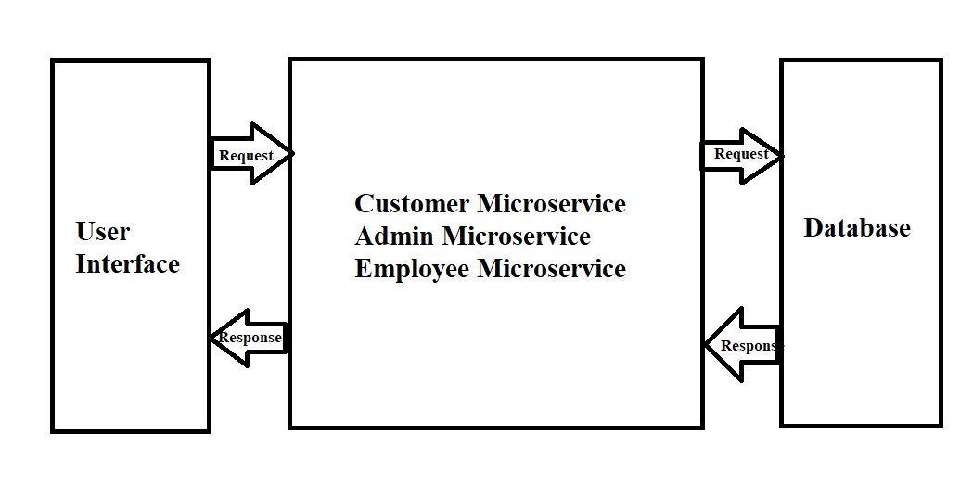
Architectural Diagram

